Slide 1
”DIKSHA” Sundaram Fin.Tech 2025
Journey Presentation –week 10
Anil Rasa
Date : 20-Apr-2025

Slide 2

Topics Covered in Tenth Week !

Slide 3
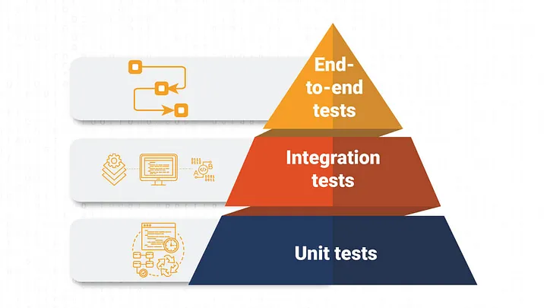
Learning 1 | My takeaways
→Forms in Angular
→Angular Testing
→Design pattern
→Pipes

Slide 4
Pipes:
pipes are used to transform data in templates. They are a convenient way to format values in the view without changing the data itself.
Pipes are :→Date Pipe, UpperCase Pipe, LowerCase Pipe, Currency Pipe,Decimal Pipe
Syntax:{{ value | pipeName[:arg1[:arg2[:...]]] }}
Forms:
Types of Forms in Angular
Template-driven Forms
Reactive Forms
Angular Testing:
Angular supports two main types of testing
Unit Testing
End-to-End (E2E) Testing
Design Pattern :
S – Single Responsibility Principle (SRP)
O – Open/Closed Principle (OCP)
L – Liskov Substitution Principle (LSP)
I – Interface Segregation Principle (ISP)
D – Dependency Inversion Principle (DIP)
Q

Slide 5
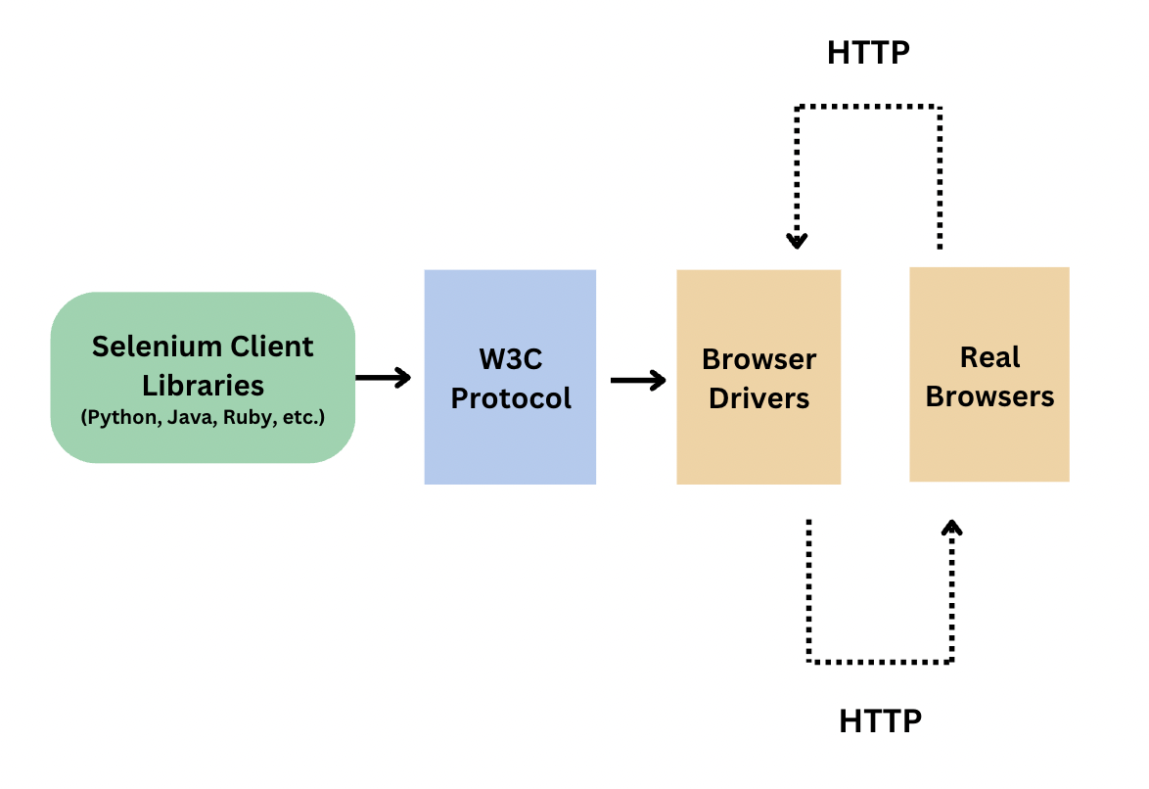
Learning 2| My Takeaways
→ Security concepts
→ Selenium Testing
→ Components of Selenium
→ Selenium Web Architecture

Slide 6
Security Concepts in Design Patterns:
1)Authentication
Verifies the identity of a user or system.
Common implementations: Login systems, tokens (JWT), certificates.
2)Authorization
Determines access rights or privileges.
Ensures that only authenticated users can access resources they're permitted to.
Selenium Testing:
→An open-source tool used for automating web applications.
→Primarily used for functional and regression testing.
Selenium Components:
Selenium IDE
Selenium WebDriver
Selenium Grid
→Supported Languages:-(Java,Python,C#,Ruby)
Selenium Web Architecture:
Selenium WebDriver architecture consists of the test script (client library) communicating with the browser-specific driver (e.g., ChromeDriver), which then interacts with the browser via native OS calls. This enables execution of commands like clicking, typing, or navigating directly within the browser.

Slide 7
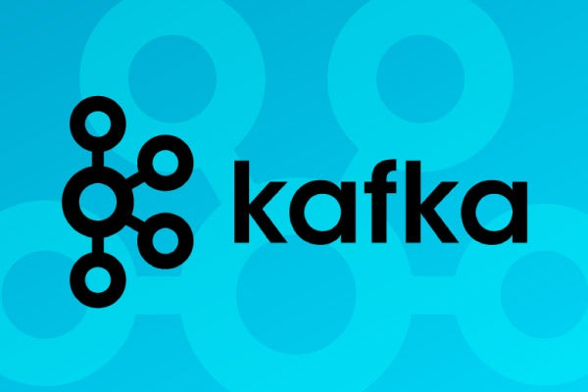
Learning 3| My takeaways
→Kafka
→Components of Kafka

Slide 8
Kafka:
Kafka is a distributed streaming platform, an open-source project developed by the Apache Software Foundation, designed for building real-time data pipelines and streaming applications.
Key Features and Functions:
1) Data Pipeline and Streaming:
2)Messaging Broker
3)Scalability and Fault Tolerance:
4)Durability and Reliability:
5)Low Latency:
Components of Kafka :
1)Producer →Sends data (messages) to Kafka topics,Acts as a data source.
2)Broker→Kafka server that stores and serves messages,Handles message persistence and client requests.
3)Topic →A category or feed name to which messages are sent,Topics are split into partitions.
4)Partition→A topic is divided into multiple partitions for scalability,Each partition is an ordered, immutable sequence of records.
5)Consumer→Reads messages from a topic,Can be grouped into consumer groups for load balancing.
6)Zookeeper→Coordinates and manages Kafka brokers,Handles configuration, leader election, and cluster state.

Slide 9
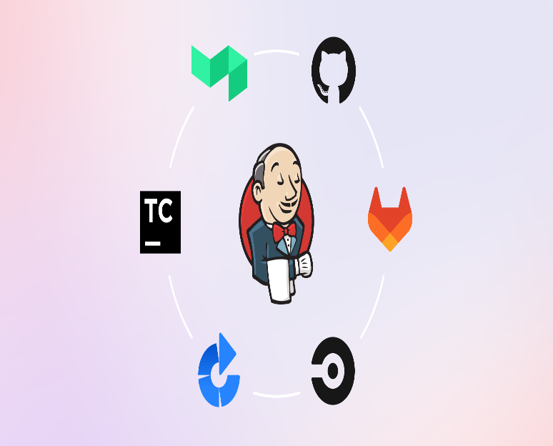
Learning 4 | takeaways
→CI/CD Using Jenkins
→Docker

Slide 10
CI/CD Jenkins:
The purpose of Jenkins is to automate the entire software development lifecycle, especially Continuous Integration (CI) and Continuous Delivery/Deployment (CD)
Purpose of Jenkins:
→Automates Code Integration
→Enables Continuous Delivery/Deployment
→Runs Automated Tests
→Supports Plugin Integration
→Provides Continuous Feedback
→Builds Once, Deploys Anywhere
→Easy Monitoring & Logs
Docker:
Docker is an open-source platform that enables developers to automate the deployment of applications inside lightweight, portable, and self-sufficient containers.
→Containerization
→Lightweight & Fast
→Portability
→Simplified Deployment
→Docker Components:
→DevOps Integration

Slide 11
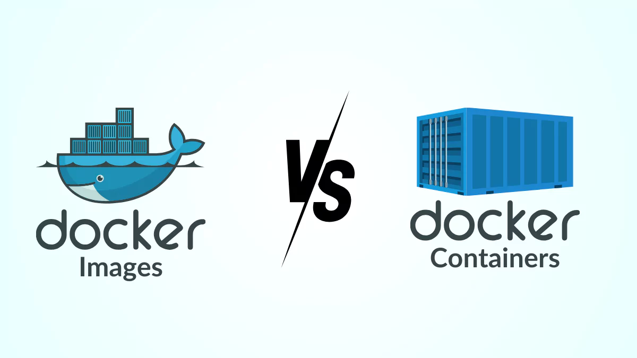
Learning 5 | takeaways
→Docker Image
→Docker Container
→Kubernetes

Slide 12
Docker Image:
→A Docker Image is a lightweight, stand-alone, and read-only template used to create Docker containers.
→It contains everything needed to run an application — including the code, runtime, libraries, environment variables, and configuration files.
Docker Conatiner:
→A Docker Container is a lightweight, standalone, and executable package of software that includes everything needed to run an application—code, libraries, dependencies, and runtime.
Kubernetes:
Kubernetes (often abbreviated as K8s) is an open-source container orchestration platform designed to automate the deployment, scaling, and management of containerized applications. Originally developed by Google, Kubernetes provides a powerful set of tools to manage large-scale containerized environments, ensuring that applications run efficiently and consistently across different environments.
Key Features of Kubernetes:
→Container Orchestration
→Automatic Scaling
→Self-healing
→Load Balancing
→Rolling Updates and Rollbacks

Slide 13
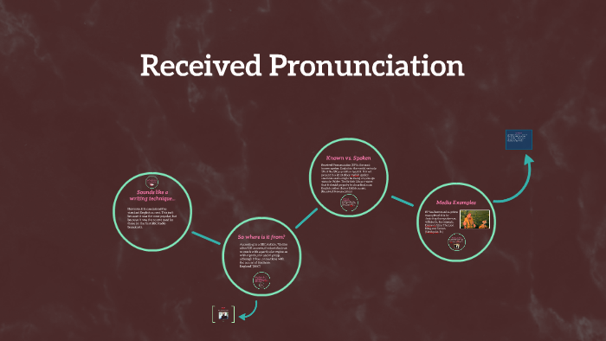
Learning 6 |takeaways
→Business idioms and phrases
→Indianism
→Received Pronunciation

Slide 14
Business idioms and phrases:
An idiom is a group of words with a meaning that is different from the literal meanings of the individual words.
→Think outside the box – Be creative or try new ideas.
→The ball is in your court – It’s your turn to make a decision or take action.
→Back to the drawing board – Start over with a new plan or idea.
→Touch base – Talk or check in briefly with someone.
→Get the ball rolling – Start something, like a project or task.
→On the same page – Agree or understand something the same way.
→In the loop – Included in communication or decisions.
Indianism:
Indianism refers to words, phrases, or sentence structures that are commonly used in India when speaking or writing English.But they may sound unusual or incorrect to native English speakers. They often come from direct translations of Indian languages or habits from local usage.
Received Pronunciation :
Received Pronunciation (RP) is a standard accent of British English. It’s often associated with educated speakers, traditional BBC newsreaders, and sometimes called "Queen's English" or "Oxford English".
→Neutral & Formal
→Non-Regional
→Used in Education & Media
→Not widely spoken today

Slide 15
Thank You

